Slide 1

Managerial Accounting
Bob Marshall, MD MPH MISM FAAFP
DoD/MAMC Clinical Informatics Fellowship

Slide 2
Objectives
Overview
Discuss difference between financial accounting and managerial accounting
Areas covered by managerial accounting
Review managerial accounting reports
Discuss the key costs associated with managerial accounting
Review and discuss the cost-volume relationship
Review role of managerial accounting in decision making

Slide 3
What is Managerial Accounting
Process of identifying, analyzing, recording and presenting financial information that is used internally by management for planning, decision making and control
Concerned with providing helpful information and reports to internal users, such as managers and business leaders, so that they can control and plan the business activities

Slide 4
Managerial versus Financial Accounting
Financial accounting
Used to present the financial health of an organization to its external stakeholders
Presents a specific period of time in the past and enables the audience to see how the company has performed
Management or managerial accounting
Used by managers to make decisions concerning the day-to-day operations of a business
Based not on past performance, but on current and future trends, which does not allow for exact numbers

Slide 5
Additional Differences
Management accounting is presented internally, whereas financial accounting is meant for external stakeholders
Although financial management is of great importance to current and potential investors, management accounting is necessary for managers to make current and future financial decisions
Financial accounting is precise and must adhere to Generally Accepted Accounting Principles (GAAP), but management accounting is often more of a guess or estimate (since most managers do not have time for exact numbers when a decision needs to be made)

Slide 6
Managerial Accounting Information
Information on the costs of an organizations products and services
Budgets
Performance reports
Other information which assist managers in their planning and control activities
Information on revenues from an organization’s products and services, sales back logs, unit quantities and demands on capacity resources

Slide 7
Areas Covered 1 of 2
Planning and Budgeting
Plan what to sell, how much to sell, what price is to be charged to reimburse the costs of production and also earn an optimal profit
Capital budgeting and master budget are the two important topics
Decision Making
When managers have to decide whether or not to start a particular project, they need managerial accounting information to estimate the benefits of various opportunities and decide which one to choose.
Mangers often use relevant costing techniques

Slide 8
Areas Covered 2 of 2
Measurement of Performance
Managers have to compare the actual results of operations to budgeted figures to evaluate the performance of the business
They use managerial accounting techniques such as standard costing to evaluate the performance of specific departments
They then make necessary adjustments in those departments which are not performing well

Slide 9
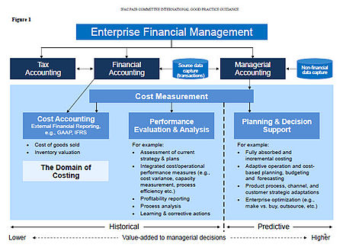

Slide 10
Managerial Accounting Reports
Budget Report
Help analyze a company's performance and helps managers analyze their department's performance and control costs
Estimated budget for a period is usually based on the actual expenses from prior years
Accounts Receivable Aging
Breaks down the customer balances by how long they have been owed
Most aging reports include separate columns for invoices that are 30 days late, 60 days late and 90 days late or more
Manager can use the aging report to find problems with the company's collections process

Slide 11
Managerial Accounting Reports
Job Costs Reports
Show expenses for a specific project
Usually matched with an estimate of revenue so the company can evaluate the job's profitability
Helps identify higher-earning areas of the business so the company can focus its efforts there instead of wasting time and money on jobs with low profit margins
Inventory and Manufacturing
Companies with physical inventory can use managerial accounting reports to make their manufacturing processes more efficient
Generally include items such as inventory waste, hourly labor costs or per-unit overhead costs

Slide 12
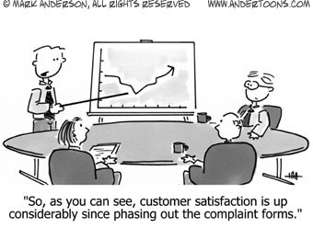
Key Costs Associated with Managerial Accounting

Slide 13
Key Costs Associated with MA 1 of 5
Direct cost: Cost that you can trace to a specific product
Indirect cost: Cost that you can’t easily trace to a specific product
Materials: Physical things you need to make products
Labor: Work needed to make products
Overhead: Indirect materials, indirect labor, and other miscellaneous costs needed to make products
Variable costs: Costs that change in direct proportion with activity level

Slide 14
Key Costs Associated with MA 2 of 5
Fixed costs: Costs that don’t change with activity level
Mixed costs: Combination of fixed and variable costs
Contribution margin: Sales less variable costs
Product costs: Costs needed to make goods; considered part of inventory until sold
Period costs: Costs not needed to make goods; recorded as expenses when incurred
Work-in-process cost: How much you paid for goods that are started but not yet completed

Slide 15
Key Costs Associated with MA 3 of 5
Finished goods cost: How much you paid for goods completed but not yet sold
Cost of goods manufactured: The cost of the goods completed during a period
Cost of goods sold: The cost of making goods that you sold
Controllable costs: Costs that you can change
Noncontrollable costs: Costs that you can’t change
Conversion costs: Direct labor and overhead

Slide 16
Key Costs Associated with MA 4 of 5
Incremental costs: Costs that change depending on which alternative you choose; also known as relevant costs and marginal costs
Irrelevant costs: Costs that don’t change depending on which alternative you choose
Opportunity costs: Costs of income lost because you chose a different alternative
Sunk costs: Costs you’ve already paid or committed to paying
Historical cost: How much you originally paid for something
Cost per unit: Cost of a single unit of product

Slide 17
Key Costs Associated with MA 5 of 5
Expense: Costs deducted from revenues on the income statement
Cost driver: Factor thought to affect costs
Process cost: Cost of similar goods made in large quantities on an assembly line
Job order cost: Cost of a batch of specially made goods
Absorption cost: Cost that includes fixed and variable product costs
Target cost: Cost goal set for engineers designing a product

Slide 18
Cost-Volume-Profit Relationships
Managerial accounting provides useful tools, such as cost-volume-profit relationships, to aid decision-making
Cost-volume-profit analysis helps you understand different ways to meet your company’s net income goals

Slide 19
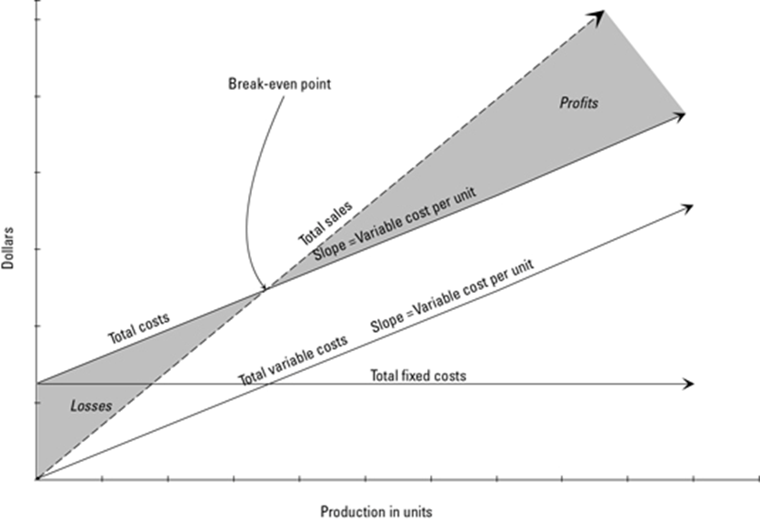

Slide 20
Interpretation of Figure 1 of 2
The bottom axis indicates the level of production — the number of units you make
The left axis indicates value in dollars
Where total sales equals total costs, the company breaks even (which is why that’s called the break-even point)
The shaded area to the upper right of this break-even point is profit
The shaded region to the lower left is net loss

Slide 21
Interpretation of Figure 2 of 2
Total variable costs are a diagonal line because the higher the production, the greater the variable costs
The total fixed costs line is horizontal because regardless of the production level, fixed costs stay the same
Total costs equal the sum of total variable costs and total fixed costs

Slide 22

Using Managerial Accounting for Decision Making

Slide 23
Managerial Accounting and Decision Making 1 of 3
Managerial accounting information provides data-driven input to everyday business decisions, which can improve decision-making over the long term
Business managers can leverage this to help make their business more successful by understanding how management accounting benefits common business decision contexts

Slide 24
Managerial Accounting and Decision Making 2 of 3
Relevant Cost Analysis
Used by company management to determine what should be sold and how to sell it
Examine the costs that differ between advertising alternatives for each product, ignoring common costs
Process is known as relevant cost analysis
Activity-Based Costing
Determine to whom they should sell the products
By using activity-based costing techniques, business management can determine the activities required to produce and service a product line
Embedded in this information is the cost of customers

Slide 25
Managerial Accounting and Decision Making 3 of 3
Make or Buy Analysis
Using make or buy analysis, manager can determine which choice is more profitable, to make or to buy a component central to the business
While this technique is certainly useful, business managers should only use these analyses as a factor in the decision
Budgeting, financial statement projections and balanced scorecards are just a few examples of how managerial accounting information is used to provide information to help management guide the future of a company

Slide 26

Questions

